Slide 1
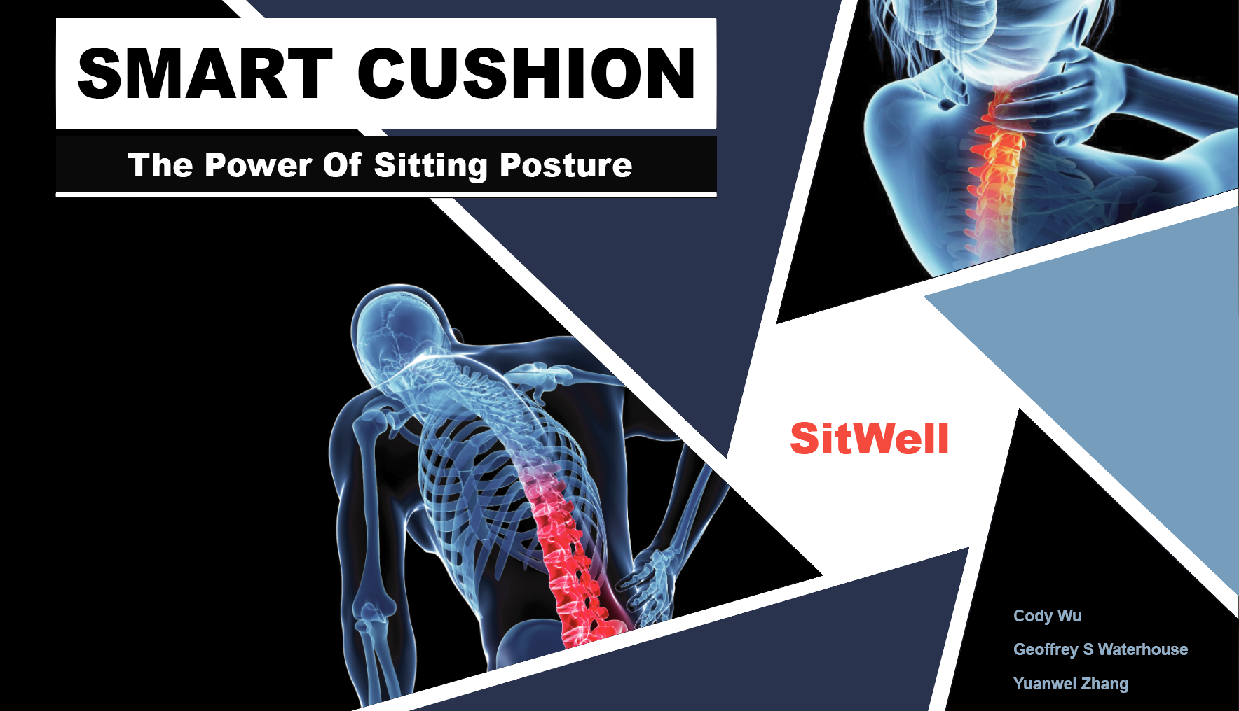

helping people fix their sitting habits
SitWell
Cody Wu, Geoffrey S Waterhouse, Yuanwei Zhang
Notes:
Hi everyone, we are SitWell, My name is C…...This is Geoff and Sebastian
Our product is a smart cushion, it will detect and help users to improve their sitting time and postures

Slide 2




Terrible Sitting Habits
Scope
¼ US adults sit more than 8 hours a day
[1]
Associated Problems
“cardio-metabolic risk, type 2 diabetes and premature mortality”
[2]
muscle weakness, cancer, anxiety/depression
[3]
cervical and lumbar spine disorders
[4]
User Behavior
We don’t know our own habits, so how can we improve?
[5]
Lack of existing solutions
Expensive non-consumer products, UpRight Go
[1]https://www.sciencedirect.com/science/article/pii/S0168822712002082
[2]https://jamanetwork.com/journals/jama/fullarticle/2715582
[3]https://www.betterhealth.vic.gov.au/health/healthyliving/the-dangers-of-sitting
[4]http://www.aaem.pl/Musculo-skeletal-and-pulmonary-effects-of-sitting-position-a-systematic-review,72599,0,2.html
[5]https://academic.oup.com/ije/article/41/5/1353/712261
Notes:
Idea from...
This idea is actually start from our personal experience. Some of the people in this cohort actually suffer from the back pain caused by sitting habits, and we went to see the physical therapy and got inspired from it
Scope_ data
Also, based on the data from the National Health and Nutrition Examination Survey, we found that… NOT ONLY US
Potential health problems cause by sitting habits
There are many associated problems, not just the common issues such as headache, neck, upper back or low back pain issues ….
Market research
And there’s no product in the market that is really trying to understand the users their own sitting habit.
So, How can we improve our sitting habit if don’t know what really cause the health issue?
30
The study, which was published in JAMA, analyzed data from the National Health and Nutrition Examination Survey (NHANES), which collects health information on a representative sample of adults over 18 years old.
We found that the vast majority of products are braces that physically pull the user’s body into ‘correct’ posture, and that this devices are not aimed towards correcting sitting posture, but standing posture.
Products aimed at correcting sitting posture were almost exclusively ergonomic/posture correcting chairs (or yoga balls). The only product we found aimed at actually detecting/classifying posture was UpRight Go, a device that sticks to the nape of the neck.
SITTING TIME
https://www.sciencedirect.com/science/article/pii/S0168822712002082
https://www.betterhealth.vic.gov.au/health/healthyliving/the-dangers-of-sitting
https://academic.oup.com/ije/article-abstract/41/5/1353/712261
https://www.ncbi.nlm.nih.gov/pmc/articles/PMC5618737/
POSTURE
http://www.aaem.pl/Musculo-skeletal-and-pulmonary-effects-of-sitting-position-a-systematic-review,72599,0,2.html
https://www.sciencedirect.com/science/article/pii/0003687077900023
https://www.google.com/search?q=Thoracic+Kyphosis&rlz=1C1CHBF_enUS792US792&oq=Thoracic+Kyphosis&aqs=chrome..69i57j69i61&sourceid=chrome&ie=UTF-8

Slide 3
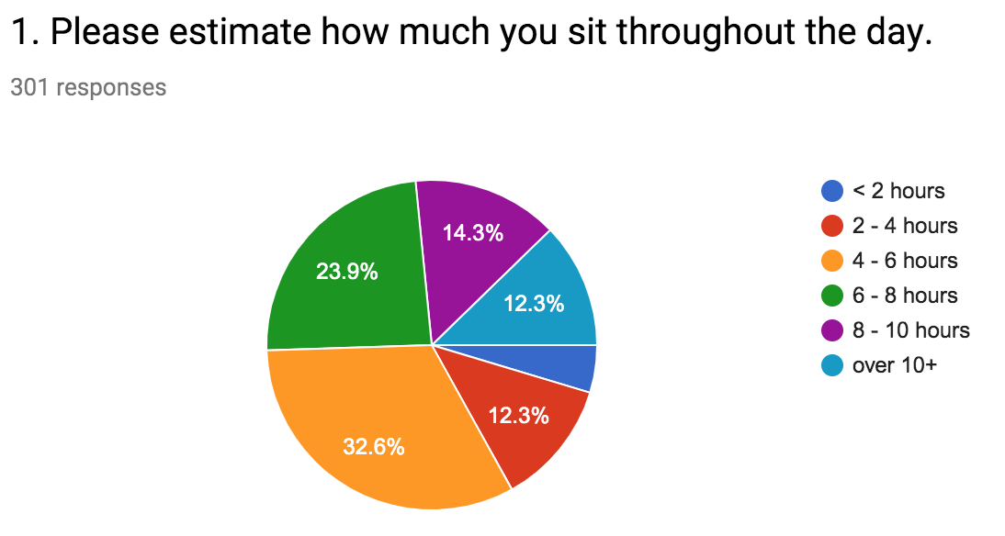
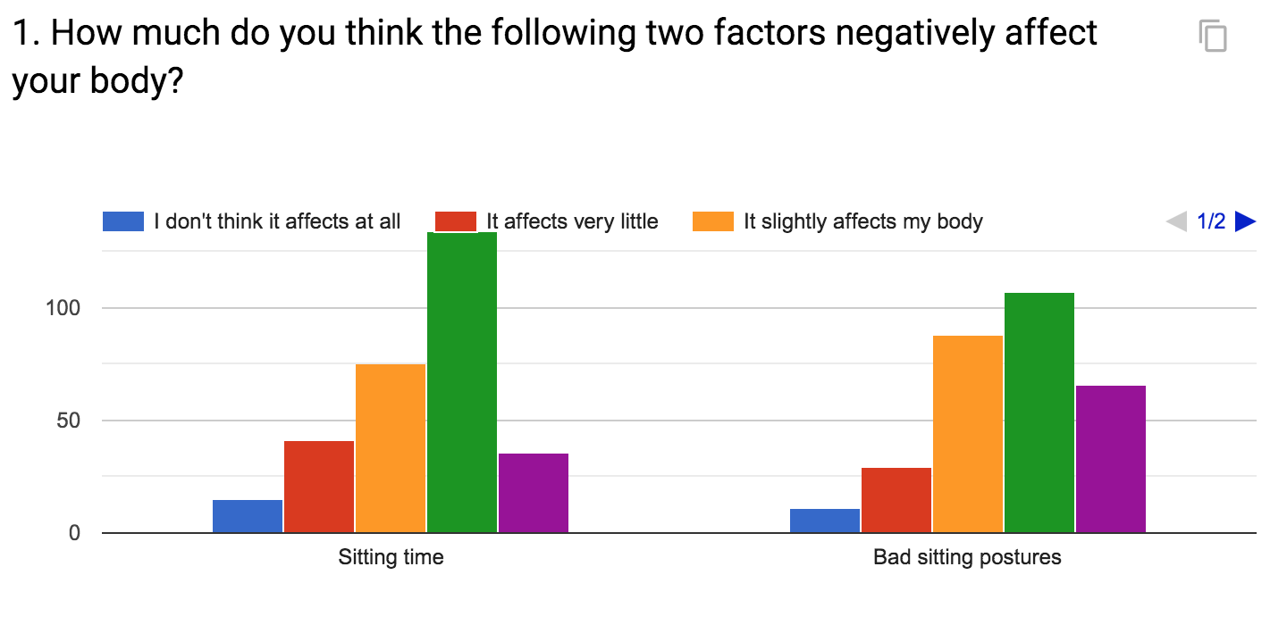
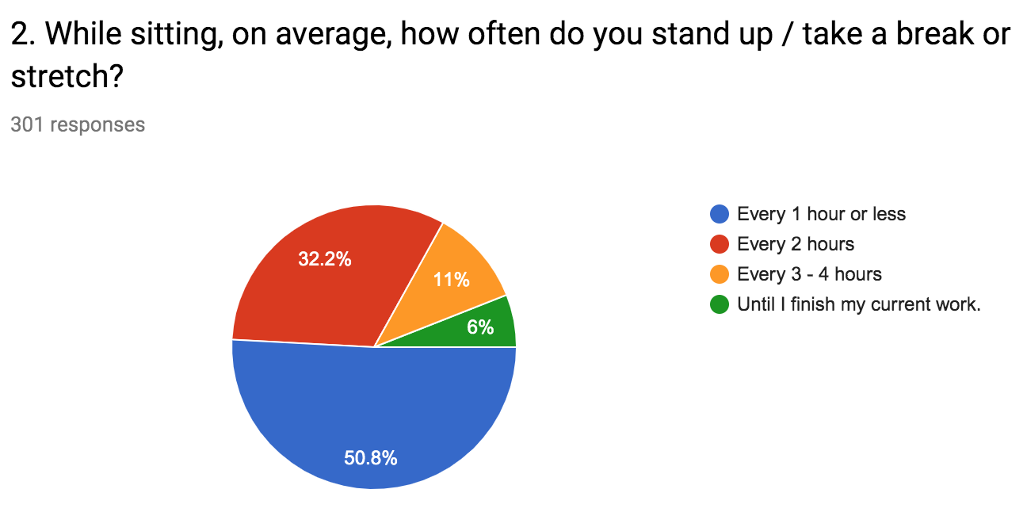
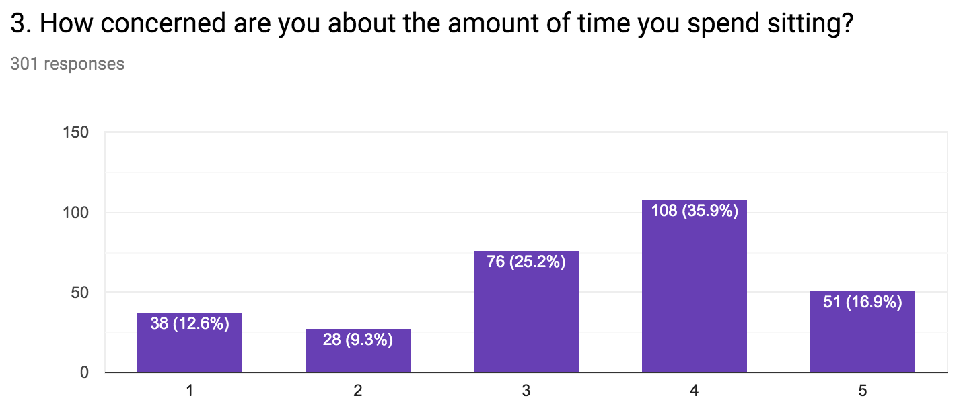
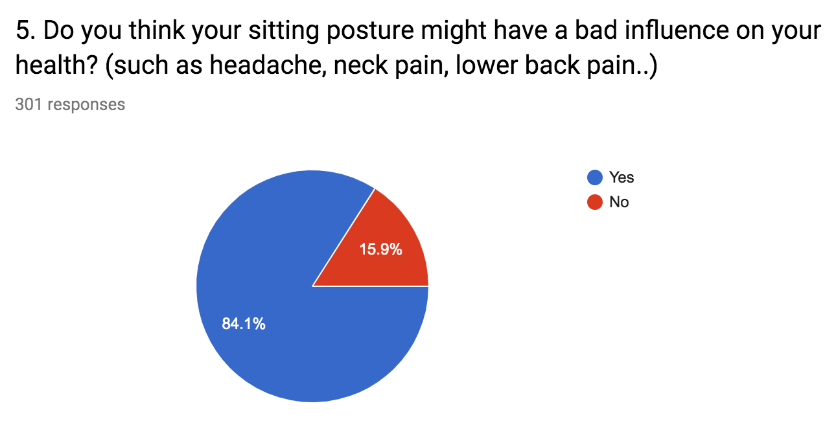
User Research
https://bit.ly/2Z5mh2i
Notes:
By doing the interviews and having a basic understanding of the problem and the market,
We design a survey and get over 300 responses,
Half of the users sit more than 6 hours,half of the people take a break or stand up every 2+ hours, half of the users are concerned about their sitting habits, more than 85% of the people concern bad sitting affect their health
Links to own survey: https://docs.google.com/spreadsheets/d/19VHJsDAoxdRkpV4vnQF-0a0ltL_bWdiwvrCeV5GKE9M/edit#gid=793808212

Slide 4
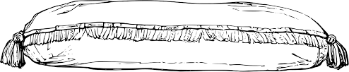
Our Solution
Daily score
Habit history
Total sitting time
Postures by %
Postures by time of day
Warnings
Physical vibration
Phone notification
Health facts
Keep your own chair
SitWell Smart Cushion
Notes:
In our app,
Overall sitting score
Track sitting history
Sitting time,
Proportion of different postures and related side effects
Warnings to remind them stand up

Slide 5
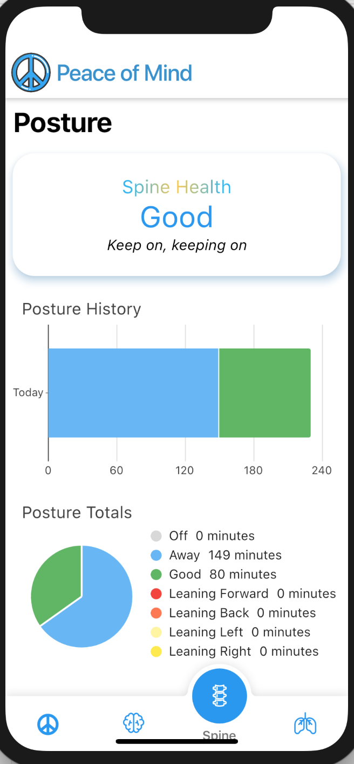
Smart Cushion
Notes:
(30 Seconds max)
Our design is a smart cushion, but think about it, solely detecting the posture doesn’t change much of the user’s behavior. So we decide to cut from a user bahavior angle to solve the problem. Our system not only detect the posture, but keeps track of the sitting habits as long as the sitting history, on top of the current status.
Better feedback on posture habits
Both in the moment and long term
Current status
Posture history, user habit,
Pop out side effects

Slide 6
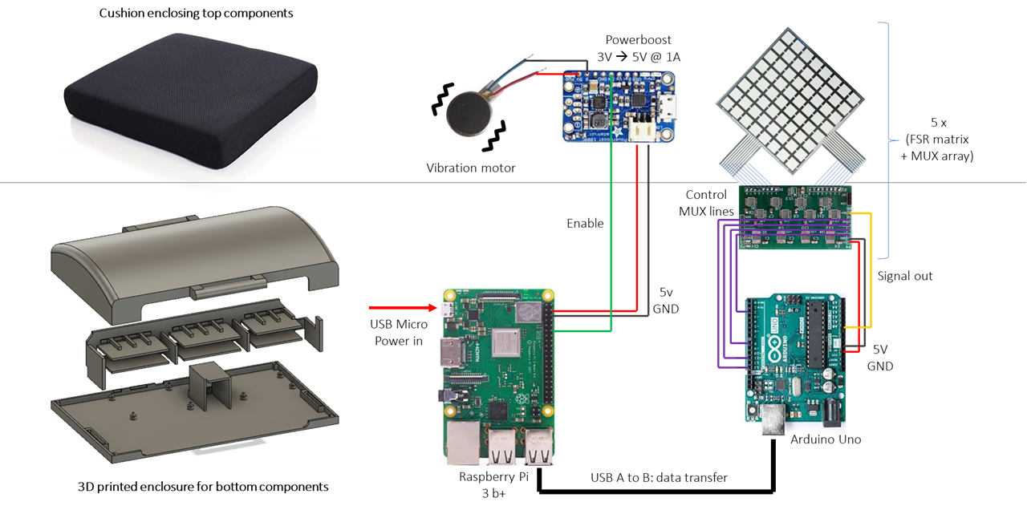
Hardware
Notes:
(20-30 seconds)
diagram

Slide 7
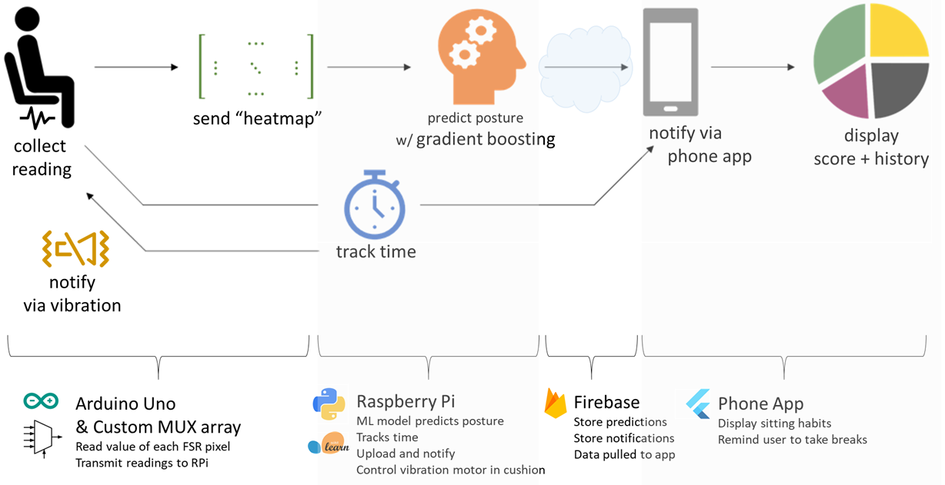
Software
Notes:
(about 20-30 seconds)
Talk about Software design changes: algorithms, pca, shrink down to 5 features
Once the reading collected, send the pressure “heat map” to the raspberry pi to do machine learning.
During this process, We tried bunch of algorithms, knn, random forest, gradient boosting, cnn.
Once we get the prediction, we will send it to

Slide 8
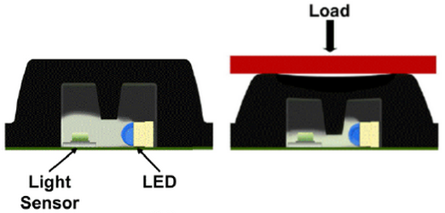
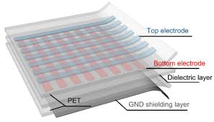
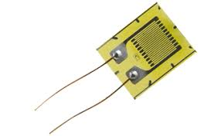
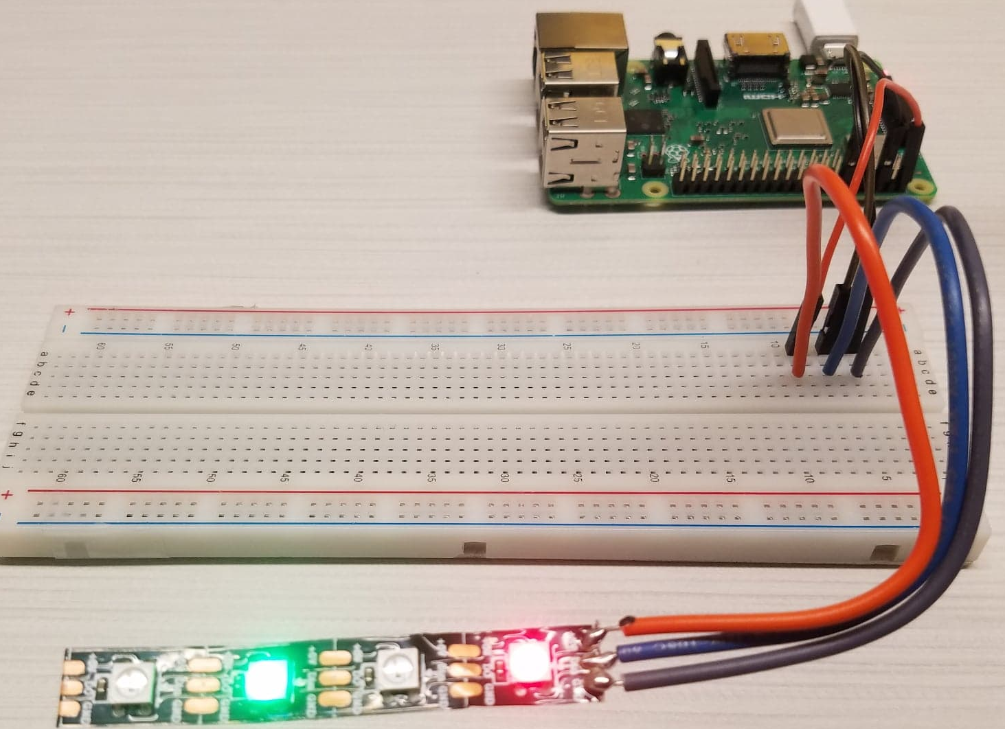
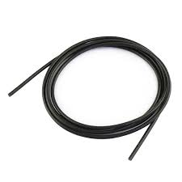
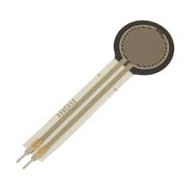
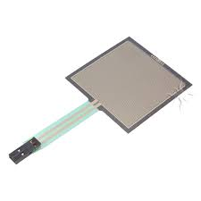
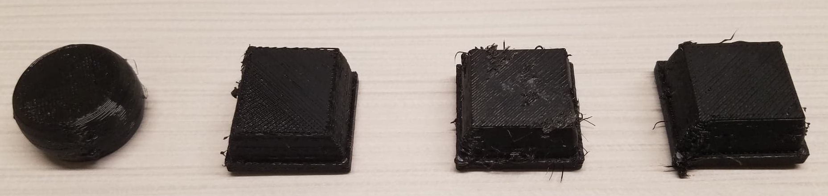
Prototype / Iterations
[1]https://www.ncbi.nlm.nih.gov/pmc/articles/PMC3574719/
Capacitive sensing mat
Strain gauge
Conductive rubber cord
FSR vs FSR matrix
PSP1: light-based, flexible pressure-sensitive technology
Notes:
20 seconds
Does user research change our design, and what drives us to change the direction
Reasons for choosing 7 layers
Why we change the material
(iteration flow)
https://www.ncbi.nlm.nih.gov/pmc/articles/PMC3574719/
https://pdfs.semanticscholar.org/ff6e/235d1008c82be144554ae5d1d20e72c3107a.pdf

Slide 9
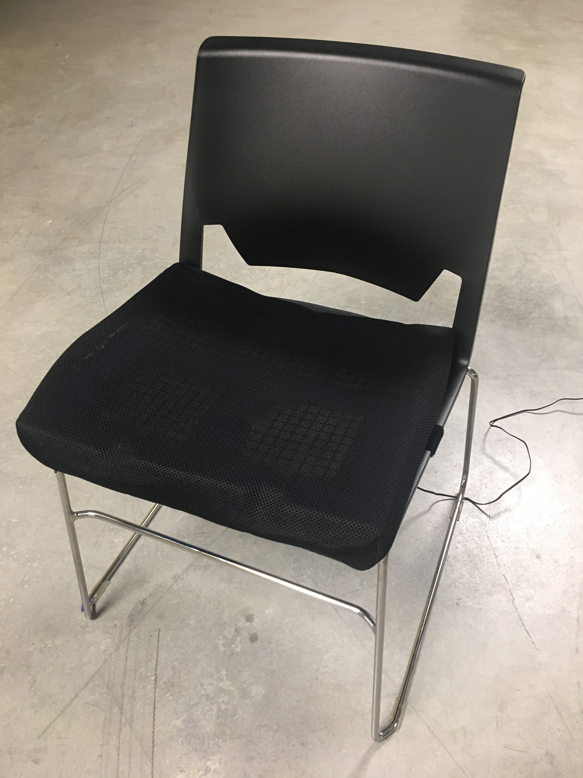
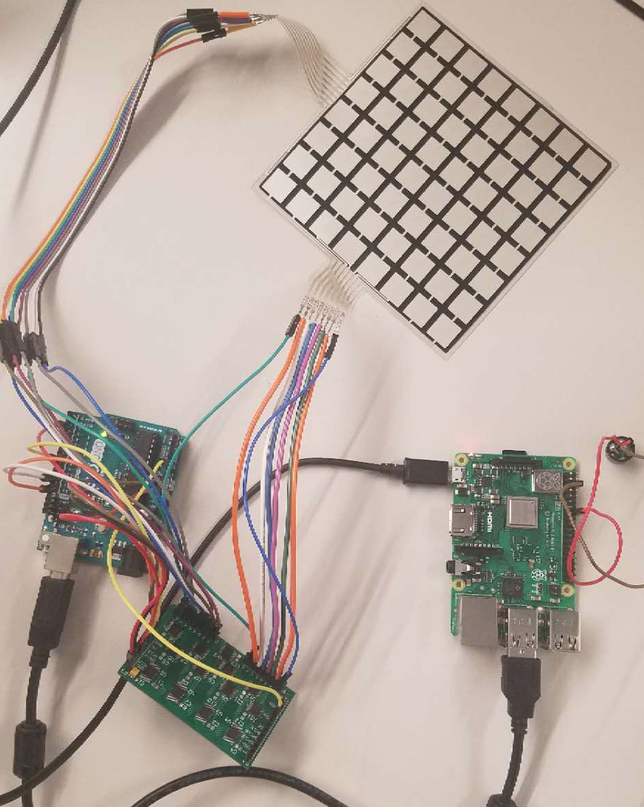
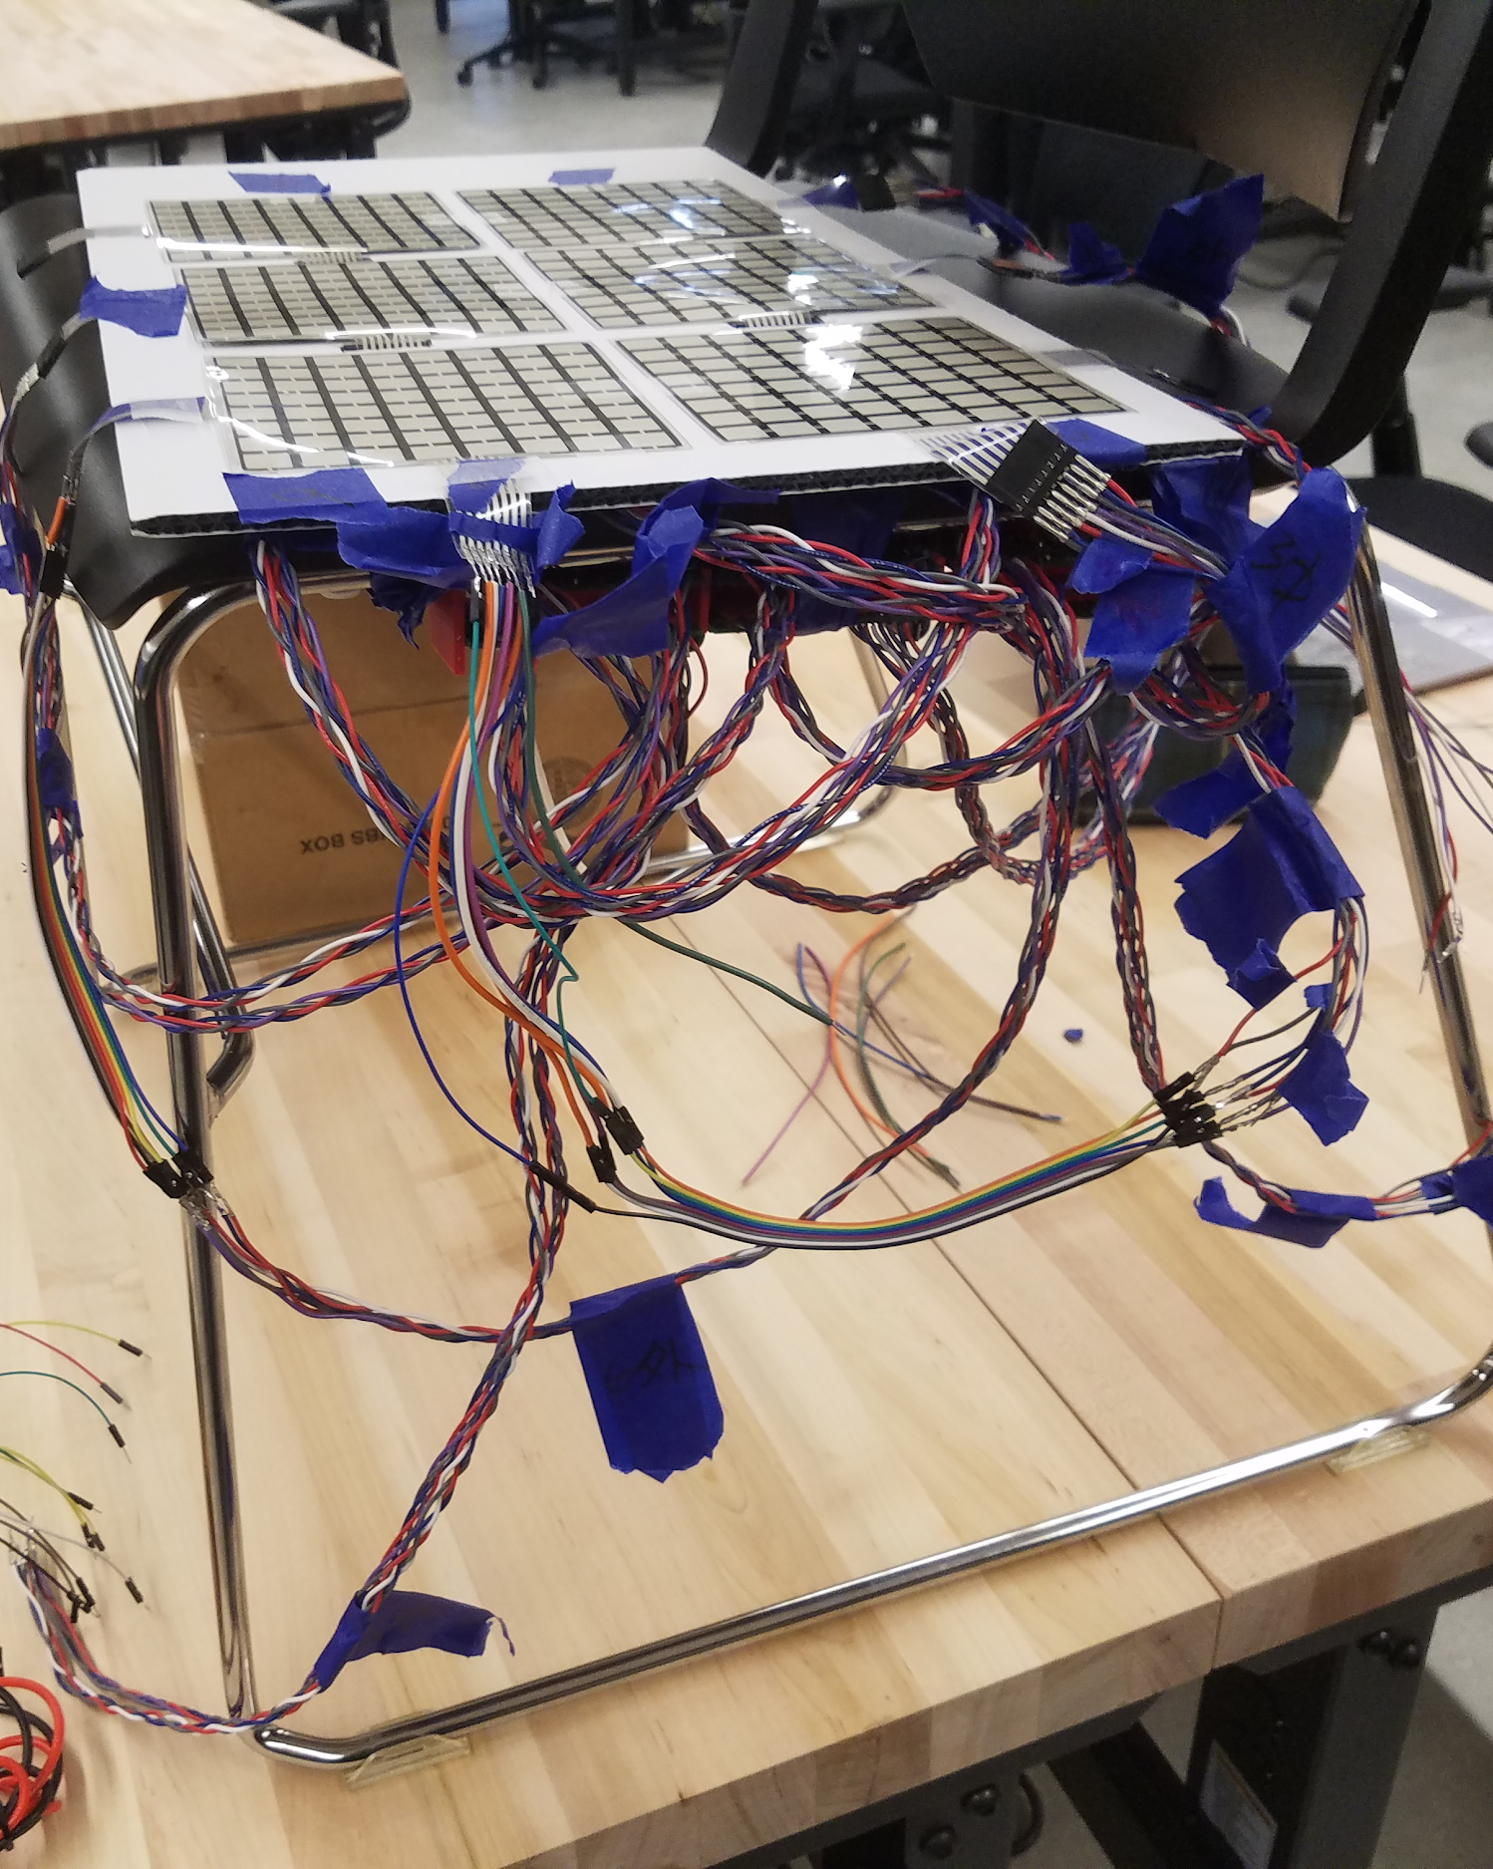
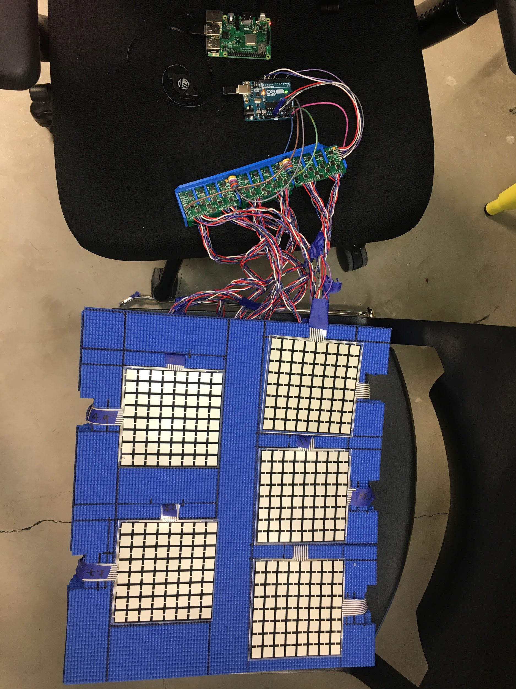
Prototype / Iterations
Single FSR matrix RPi + Arduino + MUX array + piezoelectric buzzer Model trained on small objects | 6 FSR matrices Trained on a few postures Buzzer → vibration motor | 5 FSR matrices Yoga mat for cushion PCBs enclosure in prog. Trained on a few postures PCA implemented
3 ½ FSR matrices
Matrices enclosed in cushion
PCBs enclosed below chair
Trained on 6 postures
Alerts user via app and vibration
Sitting history delivered via app
Notes:
20 seconds
Does user research change our design, and what drives us to change the direction
Reasons for choosing 7 layers
Why we change the material
(iteration flow)

Slide 10
LIVE DEMO
Notes:
Demo in under 4 mins

Slide 11
Instructor: John Raiti
TAs: Nicholas Becker, Arjun Goswami
PCB design: Feng Wang
Hardware advice: Yujing Li
Connected Team: Steven Han, Zach Badger-Markey, Michael Lai
Thank You!
We especially feel thankful for having you help us:

Slide 12

Backup Demo Video

Slide 13
Backup Demo Video

Slide 14
Reference
Media search
http://www.plugandwear.com/pw0118.asp
https://www.amazon.com/s?k=posture+correction&ref=nb_sb_noss_2
https://www.amazon.com/Upright-Corrector-Strapless-Discrete-Confidence/dp/B0747YHYZF/ref=sr_1_1_sspa?keywords=posture+correction&qid=1559211601&s=gateway&sr=8-1-spons&psc=1
https://www.amazon.com/Back-Posture-Corrector-Women-Lifestyle/dp/B07GJTBBC6/ref=sr_1_2_sspa?keywords=posture+correction&qid=1559211601&s=gateway&sr=8-2-spons&psc=1
Academic papers on posture classification via smart chairs, cushions, mattresses
https://engineering.purdue.edu/hirl/oldsite_8-10-04/publications_pdfs/SLIVOVSKY_TAN_IMECE00.pdf
https://www.hindawi.com/journals/bmri/2016/5978489/
https://www.researchgate.net/publication/257610874_Intelligent_Chair_Sensor_Classification_of_Sitting_Posture
https://link.springer.com/article/10.1186/s12938-018-0584-3
https://pdfs.semanticscholar.org/8dfd/6be2644cc53ea50462a2a1c886e01d45d8ba.pdf
http://eda.ee.ucla.edu/pub/J79.pdf
Survey
https://docs.google.com/forms/d/1QD-OWEwMmAZGDdR-phcK-7XeumFj3u2wazh0w05PTY4/edit

Slide 15
Budget
Budget |  | Leftover |  | Spent
$500 |  | $67.25 13% |  | $432.75 87%
Unused |  | Used
$81.06 16% |  | $351.69 70% | Vibration motor Cushion Velcro Straps MUX, op amps, capacitor FSR matrices

Slide 16
M2 to M3 Delta
From one single sensor to a series of 5 (3 ½) connected sensors
Completed enclosure
More aesthetic and comfortable cushion design
Machine learning implemented, PCA, gradient boosting
Phone notification, vibration alert for taking breaks
Connected device with other groups

Slide 17
Reflection
Some FSRs failed. We have some issues with either the PCB or the wires. Super detailed planning and meticulous inspection helps.
The machine learning model is not that stable as we expected. Part of the reason might because of the unstable connections between sensors. ML models need stable environments and/or lots of data to work.
Estimate cost of time. It is key to assessing which projects you should take.
User research is key. We would have changed some major things had we heard some user feedback earlier.
Don’t give up. We had so many things fail again and again. Our final prototype is not perfect, but it is as good as it is because we persevered and just experimented until problems were solved.

Slide 18
Future Work
If this project were to be continued, what should be next?
Fix the other two sensors. Right now only 4 are working.
Improve our machine learning model result and add more postures
Data augmentation to improve usefulness of smaller data set and decrease new user setup time
Train a general model that can be retrained per user to decrease training time
Find a better way to collect user data (how to collect user’s own data without standing up and sitting up so many times?)
Cost down to increase marketability - custom boards
In what ways is this project and/or technology extensible?
Based on the postures we detect, customized suggestions for the users
Combine the back support (improve the accuracy of detecting postures)

Slide 19
Other things
Anything else you want to document/show

